Slide 1


Marginal PDF
Fact:
The PDFs of X and Y are termed “marginal PDFs”

Slide 2

Example
Given:
Find the marginal PDFs of X and Y

Slide 3

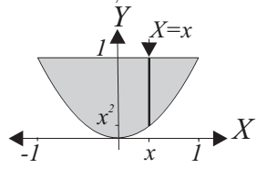

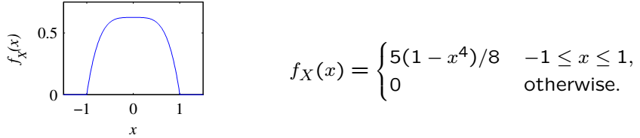
Solution
For

Slide 4

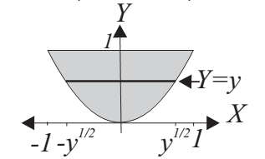
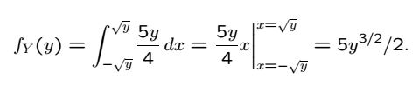
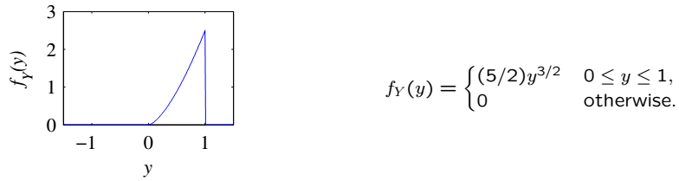
Solution Continued
For

Slide 5
Acknowledgements and Citations
Parts of these slides are adapted from the following resources:
Power Point Lecture Slides for the Textbook http://bcs.wiley.com/hebcs/Books?action=index&bcsId=8676&itemId=1118324560
John Tsitsiklis. 6.041 Probabilistic Systems Analysis and Applied Probability, Fall 2010. (Massachusetts Institute of Technology: MIT OpenCourseWare),http://ocw.mit.edu (Accessed 13 Apr, 2015). License: Creative Commons BY-NC-SA

